Slide 1

Region Performance Visualization

Slide 2

AGENDA
INTRODUCTION
FILTERING DATA
CLEANING DATA
AVERAGE SALES
TOTAL SALES (MORE ABOUT FURNITURES)
COMPARISION OF PROFIT & SALES
REGGRESION OF SALES AND DISCOUNT
SALES FOR EACH PRODUCT
DASHBOARD OF SALES & PROFIT
HIGHEST ORDERED PRODUCTS

Slide 3

🏢 Domain (Industry Context) ABC Electronics operates in the consumer electronics sector, focusing on regional and category-based sales performance. 📊 Project Introduction This project involves analyzing ABC Electronics’ sales data to uncover insights across regions and product categories using Excel. 🎯 Project Objective The goal is to clean and analyze the data, apply relevant formulas, and build a dashboard that highlights top-performing areas and key sales trends.
Introduction

Slide 4

Let’s look into our data set

Slide 5

Filtering Data
How we does filters work?
By simply clicking on “Sort & Filter”, we get the dropdown option in every column.
We selected “South” in the region's column and “Furniture” in the product's column for giving an example.
How does it help?
Which helps us filtering the data as per our requirements.
By this we can get a clear vision where are we lacking and which is the strongest area overall.

Slide 6

CLEANING DATA
How do we ‘Clean Data’?
In order to clean the data, we need to understand the issues in it.
Once we have figured that out, we need to use different formulas for cleaning the data, as mentioned below:
Trim
Upper/Lower
Proper
How it helps us?
Cleaning data in Excel ensures accuracy, consistency, and reliability in analysis, enabling meaningful insights and error-free reporting.

Slide 7
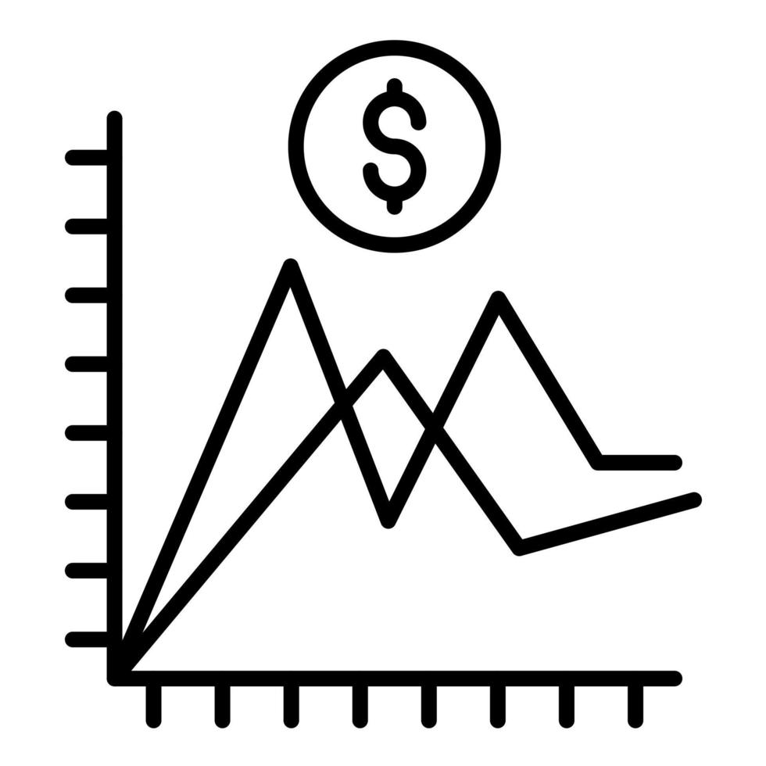
Average Sales (All Regions)
How to calculate the ‘Average’?
In order to calculate the average, we need to apply the below mentioned formula:
E.g. : =Average(C2:C30) {Press Enter}
[Here ‘C2’ denotes the cell from where and ‘C30’ denotes the cell till where.]
What does it shows?
It clearly shows that we are currently doing great in North Region in average sales point of view.
However, we can focus more on East and South Region, by understanding the reason behind low sales average.

Slide 8

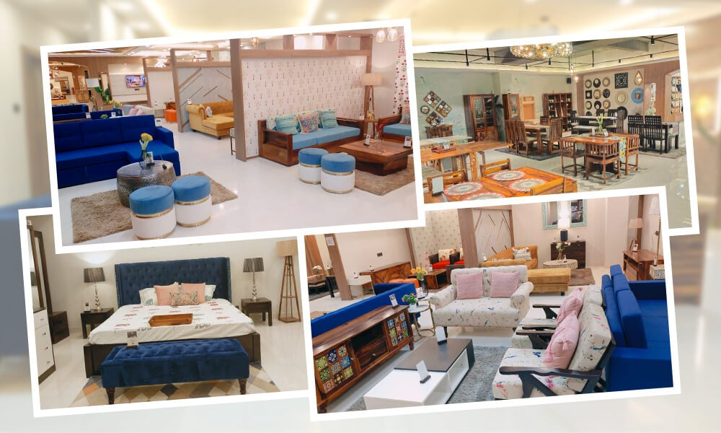
Total Sales & Furniture Data
{Total Sales}
The top to Regions Leading with high sales are North and East.
Whereas West is the region where we really need to work upon. In order to improve are total sales for the entire Market.
{ Furniture Data }
We are currently offering an Average Discount of 25.23%, according to all the regions.
The current Average Profit that we are able to make in Furniture's category id of INR 1023.38.

Slide 9

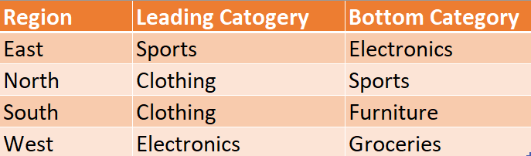
Sales and Profit by Region & Category
[ Sum of Sales ]
We have already observed that the Leading Region in sales is East and North Regions. Let’s look into Product Categories as well.
[Product Categories]
In order to become a leading seller in all the categories we need to focus more on the bottom categories. Which will eventually help us in capturing the entire market in future.

Slide 10
Regional Sales & Category Contribution Where and What We Sell Most
East has the highest sales: ₹2.59M
North follows with ₹2.54M.
South and West are slightly behind.
Sales are fairly balanced across regions.
Clothing leads with 21% of total sales.
Furniture, Groceries, and Sports each contribute 20%.
Electronics slightly trails at 19%.
Sales are evenly distributed across categories.

Slide 11

Regression: Discount (%) and Sales
The scatter plot shows no clear relationship between Discount (%) and Sales Amount.
The R² value is very low (0.0003), indicating an almost zero correlation.
Discounts appear to have minimal impact on sales performance in this dataset.
Other factors may influence sales more significantly than discounts.

Slide 12

Detailed Sales Matrix: Region vs Product Category
Clothing:
Highest total category sales: ₹21,56,007.58.
Popular across North, South, and East, less in West.
Electronics:
₹20,47,834.93 in total - Highest in West, lowest in East.
Indicates digital product demand in metro or tech-savvy zones.
Furniture:
₹20,49,496.16 – top in East, stable in all regions.
Suggests strong home decor/furnishing trend in East and West.
Groceries:
₹18,64,225.06 – lowest among all categories.
South leads; West and East underperform slightly.
Could indicate lower grocery margins or market saturation.
Sports:
₹19,92,219.96 - East leads followed by South.
Indicates an opportunity to promote active lifestyle products regionally.

Slide 13
Business Metrics Dashboard with Dynamic Filters
✅ Top Performing Product
Clothing is the highest-selling category with total sales of ₹21,56,007.58
Also yields the highest profit: ₹8,56,347.49
⚖️ Balanced Categories
Furniture and Electronics are nearly tied in total sales / Profit Margin:
Furniture: ₹20,49,496.16 / ₹8,35,080.32
Electronics: ₹20,47,834.93 /₹8,03,657.96
📉 Underperforming Category
Groceries have the lowest sales (₹18,64,225.06) and lowest profit (₹7,39,605.38)
Indicates potential overstocking, pricing issues, or lower demand
🧩 Dashboard Features to Highlight
Interactive slicers enable quick filtering by category
Toggle between sales and profit views easily
Supports faster, data-driven decisions
🧠 Strategic Takeaways
Boost focus on Clothing – leads in both sales & profit
Maintain and optimize Furniture & Electronics
Address Groceries’ low performance – review pricing/promos
For Sports, explore seasonal or bundled offers

Slide 14

High-Margin Orders
Insights from High Margin Orders ( > 50%)
Strong Profitability:
Several orders exceed the 50% profit margin threshold, signaling highly lucrative transactions (e.g., Order IDs ab899d2f, 73484eb1, 05d72e20).
Top Performers:
Exceptional margins like 192%, 148%, 224%, etc., suggest efficient cost management or effective discount strategies.
Product Category Trends:
High-margin orders are common in Clothing, Furniture, and Sports, pointing to strong pricing power in these categories.
Sales Synergy:
Many high-margin orders also report good sales amounts, amplifying their overall profitability.

Slide 15

TAKEAWAYS
Target West Region: Launch local promotions and retailer partnerships to boost sales.
Improve Grocery Sales: Enhance pricing, packaging, and promotions for better performance.
Promote High-Margin Products: Focus marketing on Clothing, Furniture, and Sports categories.
Refine Discounting: Shift from discounts to value-based selling and bundled offers.
Optimize Product Mix: Stock top sellers and reduce slow-moving inventory.
Segment Customers: Tailor offerings using regional buying behavior data.
Upgrade Reporting: Use automated dashboards for real-time insights and tracking.

Slide 16

THANK YOU
RAAMYA PANDEY
BATCH NO. - (BMAI-C-WD-E-B12)
RAAMYAPANDEY82@GMAIL.COM

